Slide 1
Exploring Real Estate Valuation Dynamics: An In-Depth Analysis of House Pricing Trends
Unveiling Insights into the Dynamics of Property Valuation through Comprehensive Exploratory Data Analysis

Slide 2
Introduction
Our goal is: to conduct a comprehensive exploration of the dataset provided, titled "Housing Data.csv", in order to understand the multifaceted factors that influence house prices. This endeavour is not merely about identifying correlations; it's about uncovering hidden patterns, outliers, and trends that hold the key to strategic decision-making in a dynamic market.
In this project, we'll do Exploratory Data Analysis (EDA). Through meticulous examination of the dataset, we aim to extract actionable insights that will inform pricing strategies, optimize property values, and ultimately enhance our competitive edge in the ever-evolving real estate landscape.

Slide 3
Problem Statement
In the dynamic landscape of the real estate market, determining optimal house prices presents a multifaceted challenge due to the influence of various factors such as location, size, amenities, market trends, and economic indicators. We are conduct a comprehensive analysis aimed at understanding these complex dynamics. By leveraging advanced data analytics techniques and visualization tools, our goal is to identify key variables that significantly influence house prices and uncover hidden patterns, correlations, and trends within the dataset. This comprehensive analysis will empower the company to make informed decisions, strategically position properties, and optimize property values in a competitive and ever-evolving real estate landscape.

Slide 4
Situation Overview
The real estate industry is inherently complex, characterized by a multitude of factors that collectively influence house prices. These factors encompass a wide range of variables, including but not limited to, location, property size, amenities, Area, and historical transaction data. The dynamic nature of these variables, coupled with their interconnectedness, adds to the complexity of the real estate market.
Navigating through these various factors is essential due to their significant impact on house prices. For example, the location of a property can have a substantial effect on its value, with factors such as proximity to amenities, area, bulit year, and sale condtion playing crucial roles.
By leveraging advanced data analytics techniques and visualization tools, we can uncover patterns, correlations, and trends within the dataset. Our recommendations can help the company strategically position properties, capitalize on market trends, and maximize returns on investments.

Slide 5
Dataset Information
The dataset provided for this analysis is named "Housing Data.csv".
The dataset encompasses a diverse range of parameters essential for real estate analysis, including:
Location: Information about the geographical location of properties, which include factors such as neighborhood, city, and region.
Size: Details regarding the size of properties, such as total area, number of bedrooms, number of badroom, and garage area.
Amenities: Features and amenities associated with properties, such as swimming pools, gardens, parking spaces, and recreational facilities.
Market Trends: Historical and current market trends, including data on housing prices and trends over time.
Historical Transaction Data: Property condition, including sale prices, year of sale, and any relevant transaction details.
The inclusion of these diverse parameters in the dataset allows for a comprehensive analysis of real estate pricing dynamics, enabling us to explore correlations, trends, and patterns that influence house prices.

Slide 6
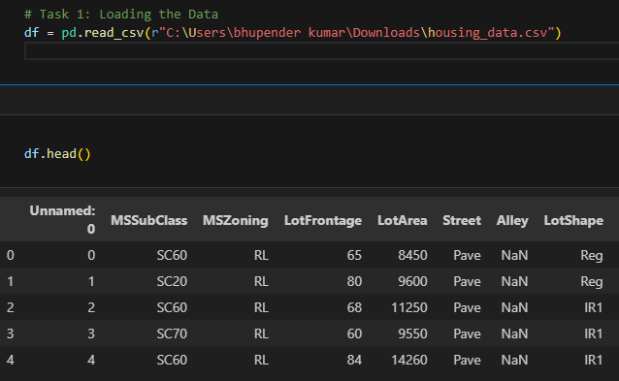
Exploratory Data Analysis (EDA)
Using Import necessary libraries like pandas, matplotlib.pyplot, seaborn, plotly.express, folium for EDA.
First we need to load data from specific location:

Slide 7
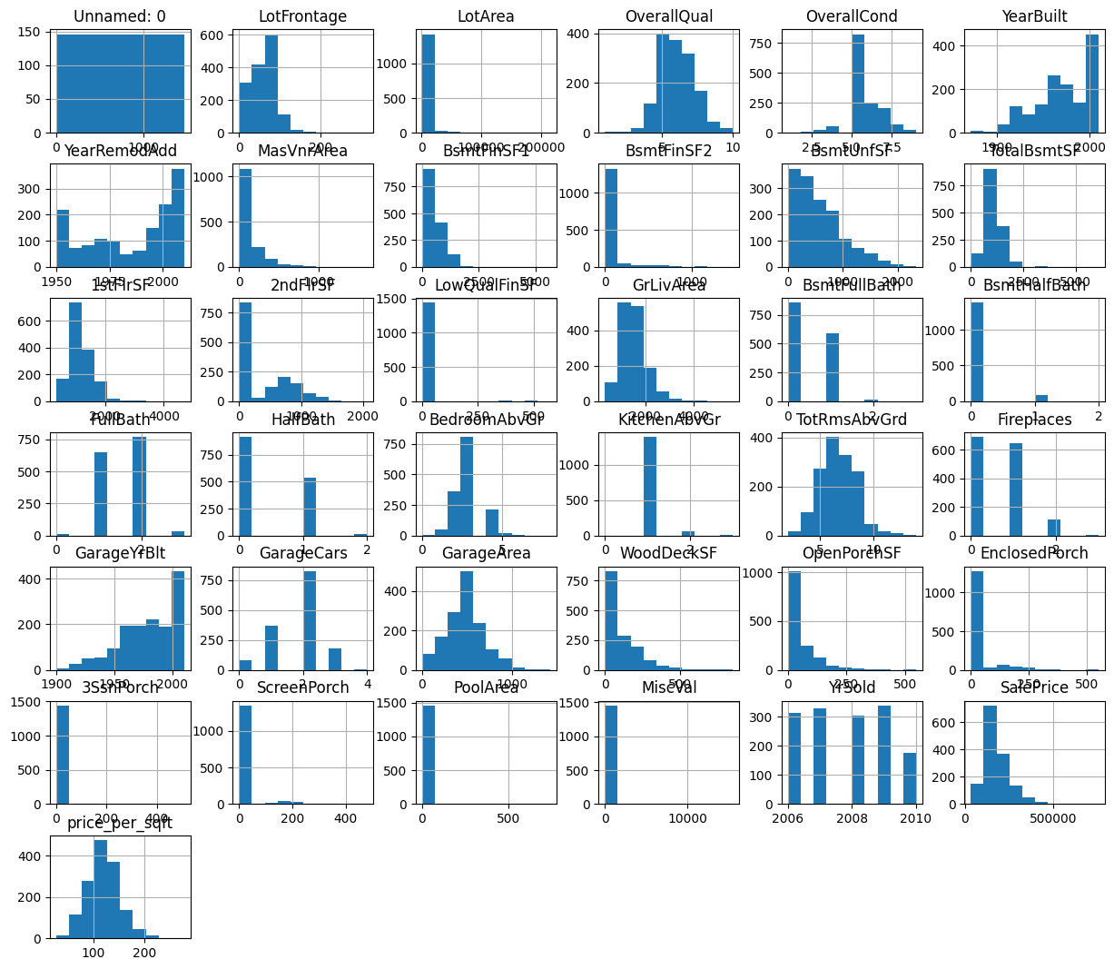
Visualize distributions of numerical features
Visualize the distributions of numerical features using histograms or kernel density plots to understand their spread and central tendency.

Slide 8
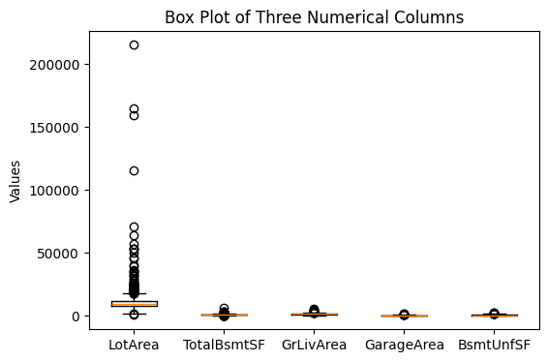
Create a box plot using Matplotlib
Specify the five numerical columns to plot

Slide 9
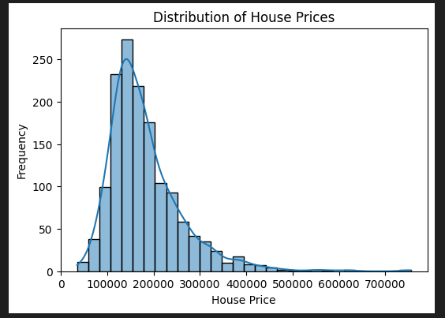
Cleaning the Data
Handling missing values by filling null values.
Filling missing values in numerical columns with the mean
Filling missing values in object columns with the mode.
Univariate Analysis:- Histogram for house prices

Slide 10
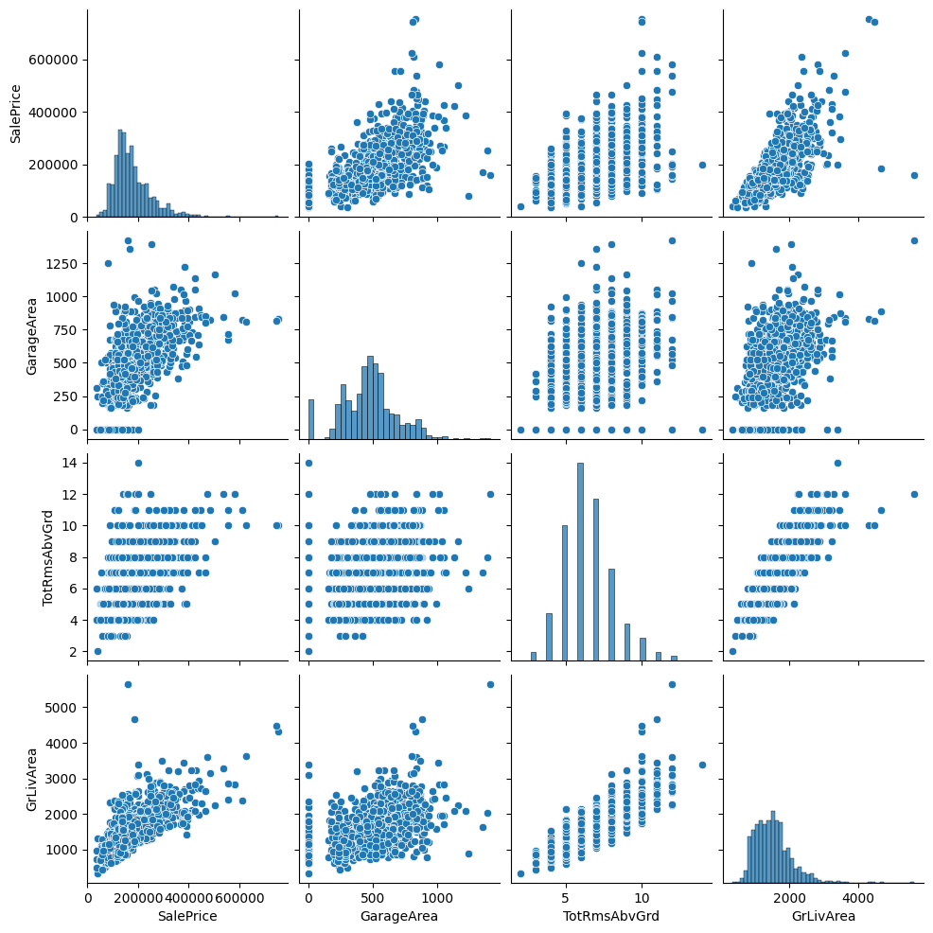
Multivariate Analysis
Scatterplot matrix for selected features:- 'SalePrice', 'GarageArea', 'TotRmsAbvGrd', 'GrLivArea'

Slide 11
Feature Engineering and Geospatial Analysis
Create a new feature “price_per_sqft” by using two feature data (SalePrice and GrLivArea).
Geospatial Analysis:- For this we need longitude and latitude so we can analysis the data accordingly.

Slide 12
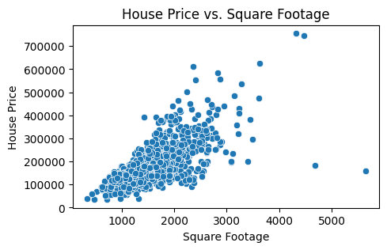
Feature Engineering and Size Impact
Scatterplot for house prices vs. square footage

Slide 13
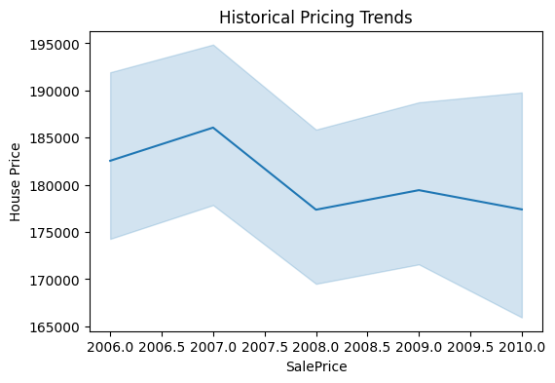
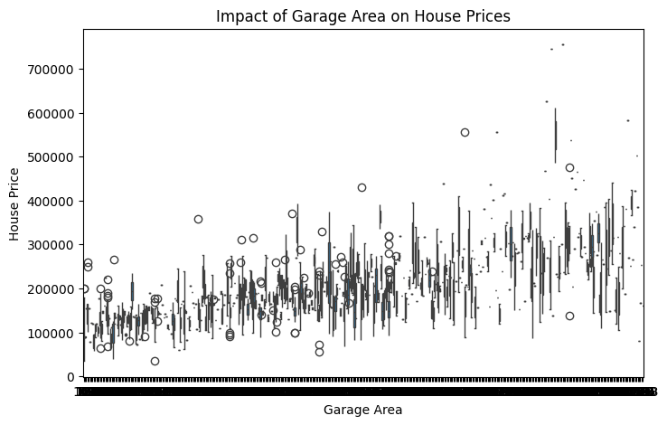
Market Trends, Historical Pricing, Customer Preferences and Amenities
Line plot for historical pricing trends.
Boxplot for house prices with/without a Garage Area.

Slide 14
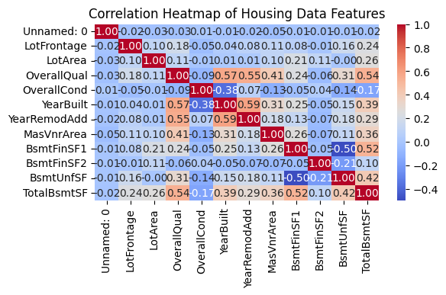
Plot heatmap of correlation matrix
Calculate correlation matrix and plot heatmap

Slide 15
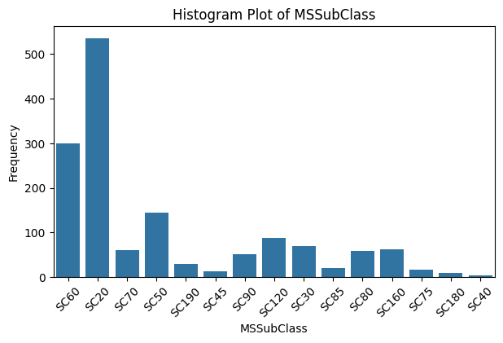
Create a bar plot using Seaborn
Specify the categorical column to plot and adjust the x-axis labels for better readability.

Slide 16
Conclusion
In summary, the presentation highlighted the multifaceted challenge of determining optimal house prices in the dynamic real estate market. It emphasized the complexity of the industry, with various factors such as location, size, amenities, market trends, and economic indicators influencing house prices.
Exploratory Data Analysis (EDA) was emphasized as a critical tool in this process. Through EDA, we can gain a deeper understanding of the factors driving house prices and extract actionable insights from raw data.
In conclusion, EDA serves as a cornerstone in understanding the dynamics of real estate pricing and making informed decisions. By leveraging EDA techniques, we can uncover valuable insights that guide our decision-making process and help us navigate the complexities of the real estate market with confidence.

